Slide 1
Dinghy
Mattias, Niklas, David, Fredrik, Jesper, Alexander, Björn

Slide 2
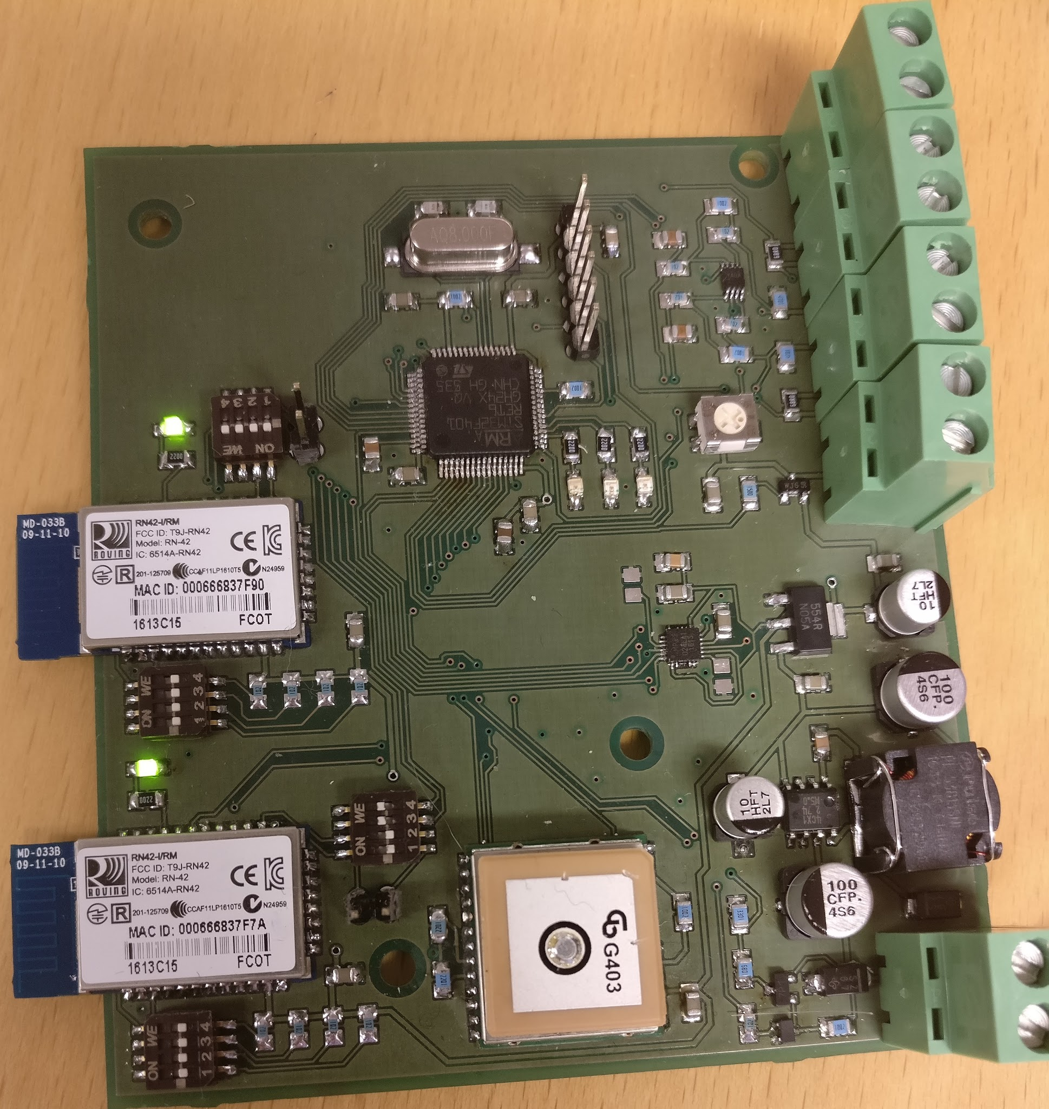
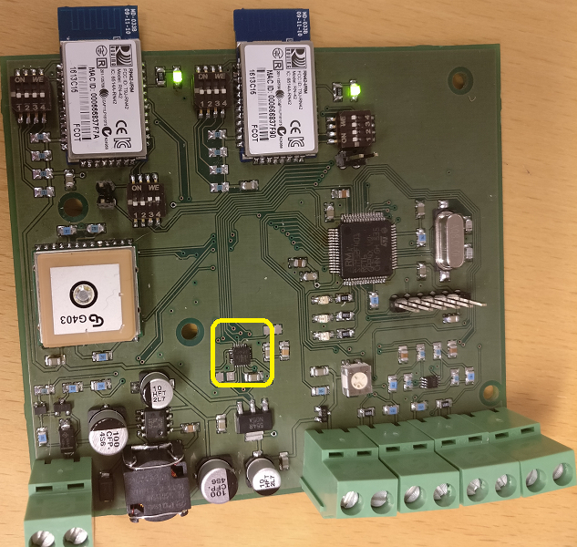
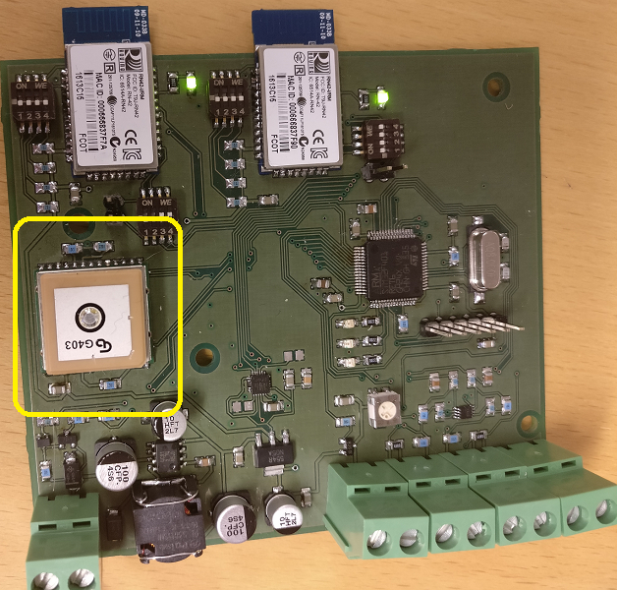
Mainboard
Complete hardware-wise
GPS works
IMU works

Slide 3
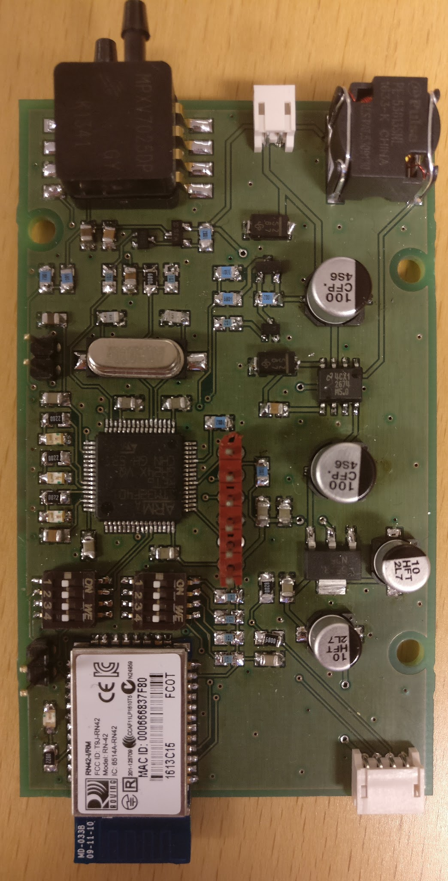
Complete hardware-wise
Only missing connecters
Centerboard

Slide 4
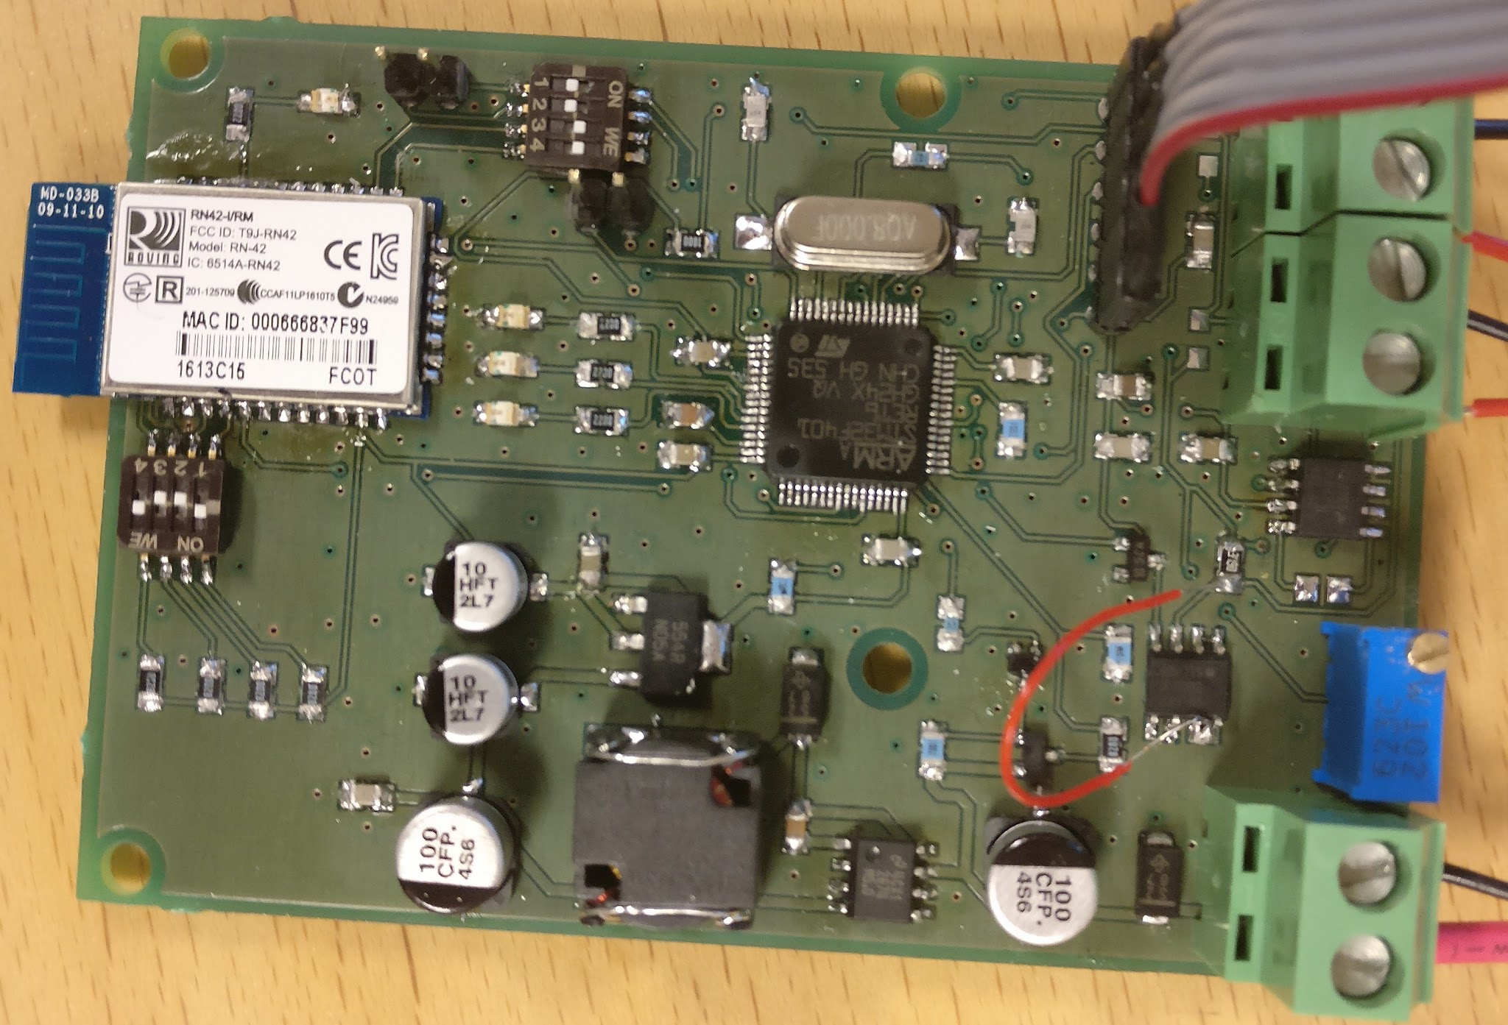
Rudderboard
Almost finished
Strain gauge amplifier circuits work, but only when the output is not connected to the MCU

Slide 5
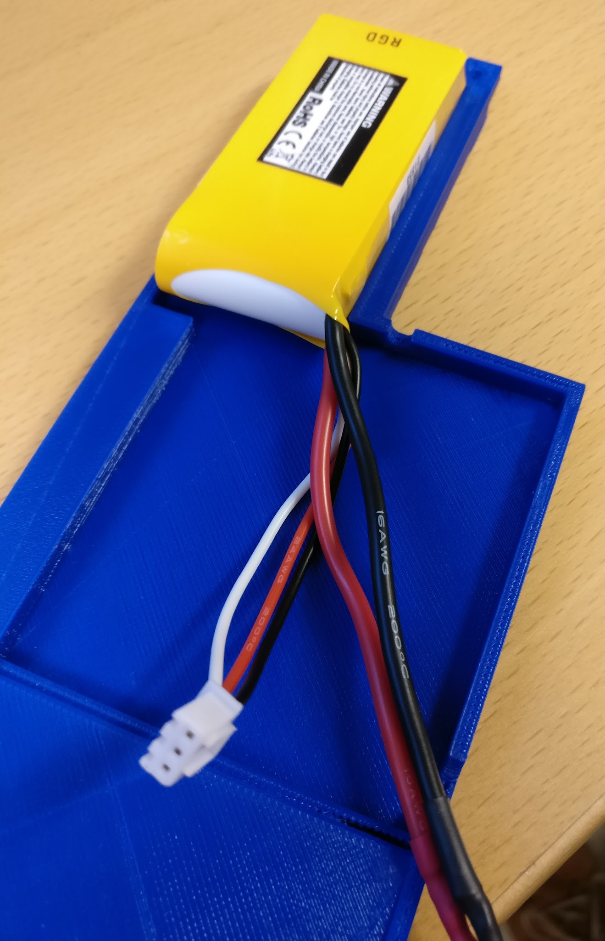
Waterproof box for centerboard
New lid fits good

Slide 6
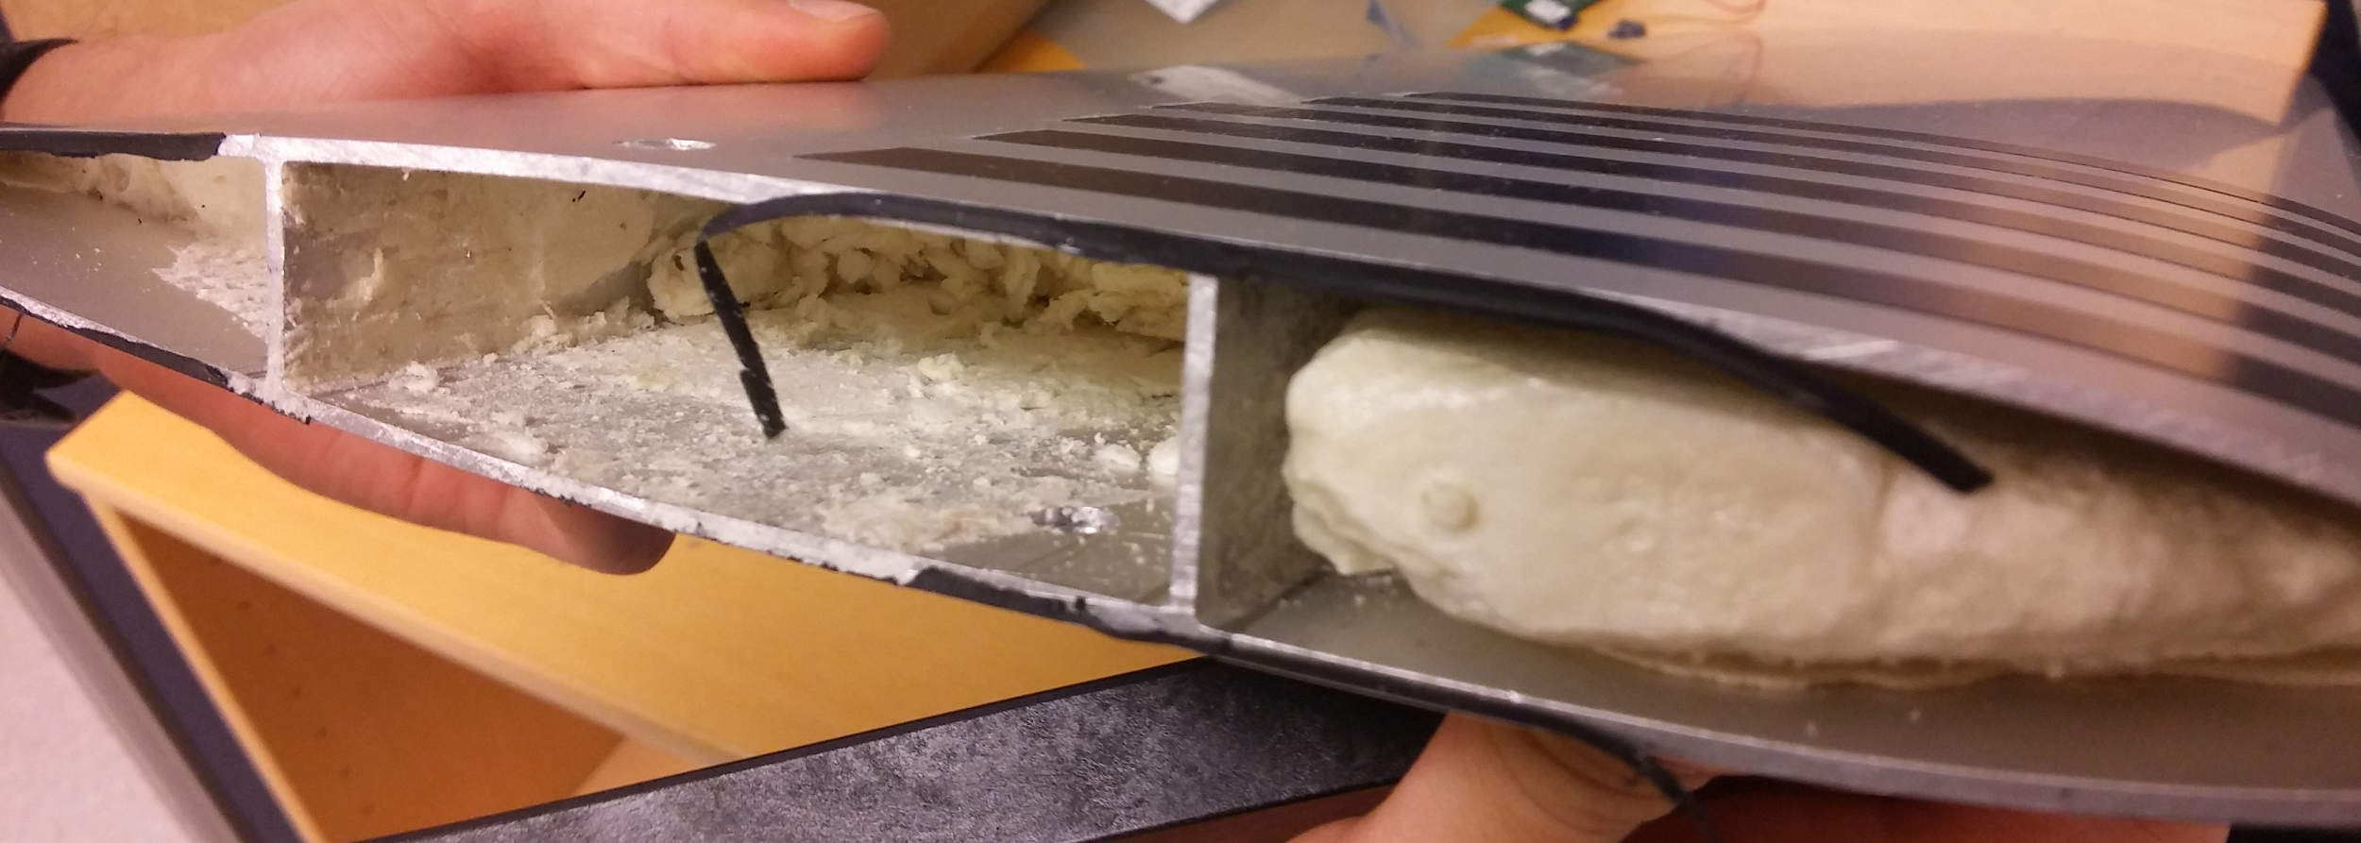
Mechanical work left
Drill holes for the pressure sensor tubes
Mill space for cables and on/off button for centerboard

Slide 7
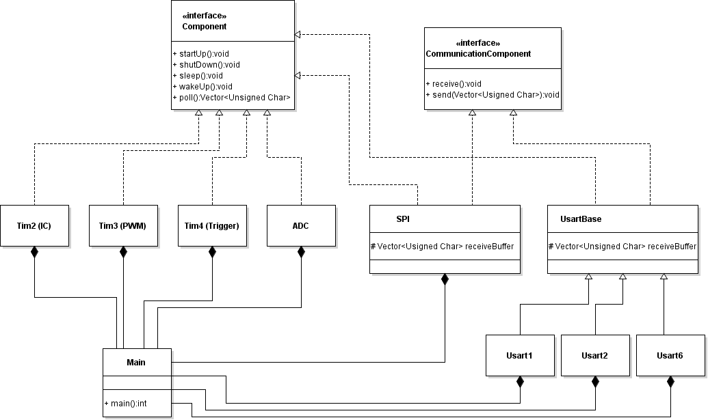
Software
Bluetooth issues
Serialized connections
GPS
Initial testing
NMEA sentence Parser
IMU
implementation
Defines
Functioning properly :)

Slide 8
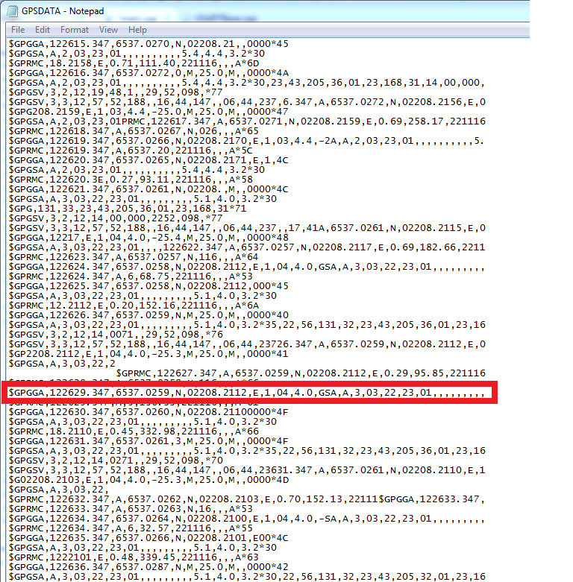
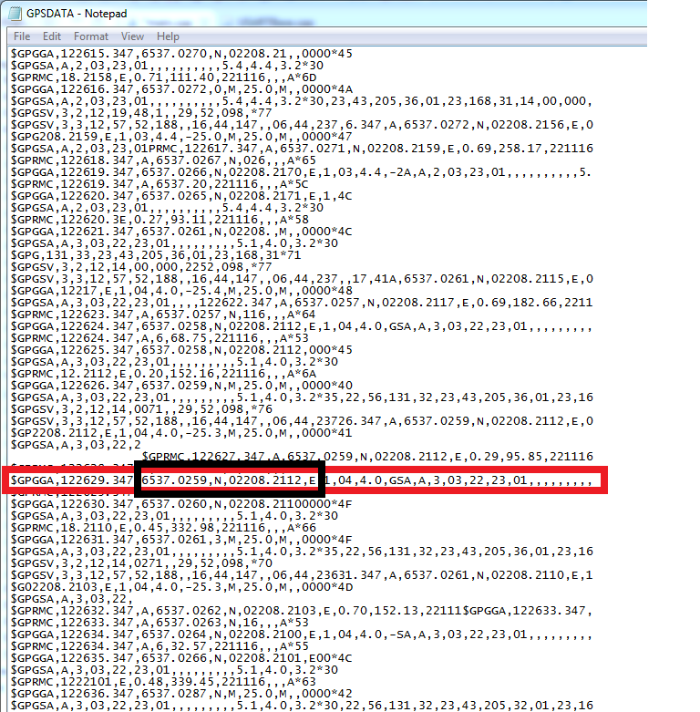
NMEA Parser
Send only necessary data
GPGGA
Messy sentences…
Inconsistent

Slide 9
